Slide 1
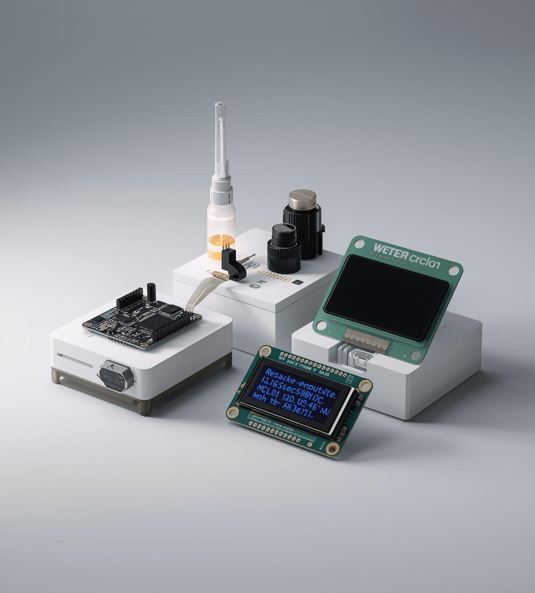

Smoke and Gas Detection
MEMBERS
23-NTU-CS-1246 AREEB FATIMA
23-NTU-CS-1256 KASHAF FATIMA
23-NTU-CS-1282 SABIKA BATOOL

Slide 2
Executive Summary
OVERVIEW OF IOT SYSTEM COMPONENTS
Temperature Sensor: DHT11
IoT Device: ESP32
Gas Sensor: MQ-2
The ESP32 is a powerful microcontroller that enables wireless connectivity, allowing for seamless integration with various sensors and real-time data processing in the IoT smoke and gas detection system.
The MQ-2 gas sensor effectively detects smoke and various gases, providing crucial data for monitoring air quality and enabling timely alerts to ensure safety in potentially hazardous situations.
The DHT11 sensor measures temperature and humidity, contributing to environmental monitoring and enhancing the accuracy of alerts, thus improving the reliability of the overall IoT detection system.

Slide 3

Fire Hazard Risks
Fire hazards from gas and smoke leaks present serious dangers to homes and lives. Traditional detectors often fail to deliver real-time alerts, leaving residents vulnerable. IoT-enabled systems enhance safety through immediate notifications, ensuring proactive measures can be taken before disasters occur.

Slide 4
Problem Statement
IDENTIFYING CHALLENGES IN SMOKE DETECTION
No Real-Time Monitoring
Lack of Mobile Alerts
Unsafe Manual Checks
Traditional smoke detectors lack the capability for real-time monitoring, which can delay response times in emergencies significantly, increasing the risk of property damage and personal injury.
Without mobile alerts, homeowners may remain unaware of hazardous conditions, which can lead to dangerous situations when immediate action is crucial for safety and prevention.
Relying on manual checks for smoke and gas detection is unsafe and inefficient, as they can easily be overlooked, resulting in undetected risks and potential disaster.

Slide 5
Project Objectives
KEY GOALS FOR SAFETY AUTOMATION
Sensor Detection
Real-Time Alerts
Mobile Notifications
The system utilizes MQ-2 and DHT11 sensors to detect gas leaks and monitor temperature and humidity, ensuring timely alerts and enhancing safety protocols for users.
Alerts are generated through a buzzer, LED lights, and OLED display, ensuring immediate notification of detection events and enabling swift action in the event of gas or smoke presence.
Integration with the Blynk app allows for real-time mobile notifications, enabling users to monitor their environment remotely, enhancing convenience, and providing peace of mind wherever they are.

Slide 6
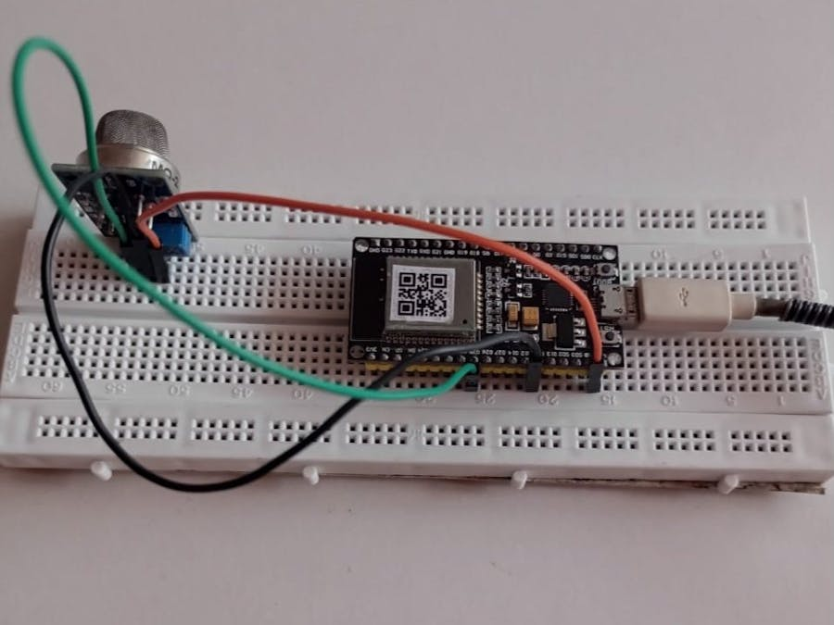
System Architecture
This page outlines the system architecture of our IoT smoke and gas detection project. It includes key hardware components such as the ESP32 microcontroller, MQ-2 gas sensor for detecting gases, DHT11 for temperature and humidity, and an OLED display for visual feedback.

Slide 7

Software Design
FIRMWARE AND IOT INTEGRATION OVERVIEW
Firmware Development
Blynk Integration
The firmware is developed using Arduino IDE and C++, enabling seamless control of sensor readings, alerts, and OLED updates while connecting with the Blynk cloud for real-time access.
The system utilizes Wi-Fi for Blynk cloud integration, facilitating real-time monitoring, remote control of features, and event logging, enhancing the overall functionality and user experience.

Slide 8
Pseudocode Overview
TECHNICAL FLOW AND IMPLEMENTATION DETAILS
System Start
Sensor Initialization
The system initializes by establishing a Wi-Fi connection, ensuring that the ESP32 is ready to communicate with the Blynk cloud for remote monitoring and control.
Sensors are configured, including the MQ-2 for gas detection and DHT11 for temperature and humidity, with baseline calibration performed for accurate readings and reliable alerts.

Slide 9

Blynk Dashboard
The Blynk app features a user-friendly interface with various widgets. These include gauges for monitoring gas levels, temperature, and humidity, along with an LED status indicator and a control button for the buzzer. This setup enhances real-time data accessibility and interaction.

Slide 10
Key Code Highlights
ESSENTIAL LOGIC FOR GAS DETECTION SYSTEM
Gas Detection
DHT Sensor Logic
The gas detection logic involves continuous sensor reading, comparing real-time values against predefined thresholds, and triggering alarms when hazardous gas levels exceed safety limits, ensuring immediate alerts.
The DHT sensor logic captures temperature and humidity data, updating Blynk with real-time information, providing users with a comprehensive overview of environmental conditions to enhance safety monitoring.

Slide 11
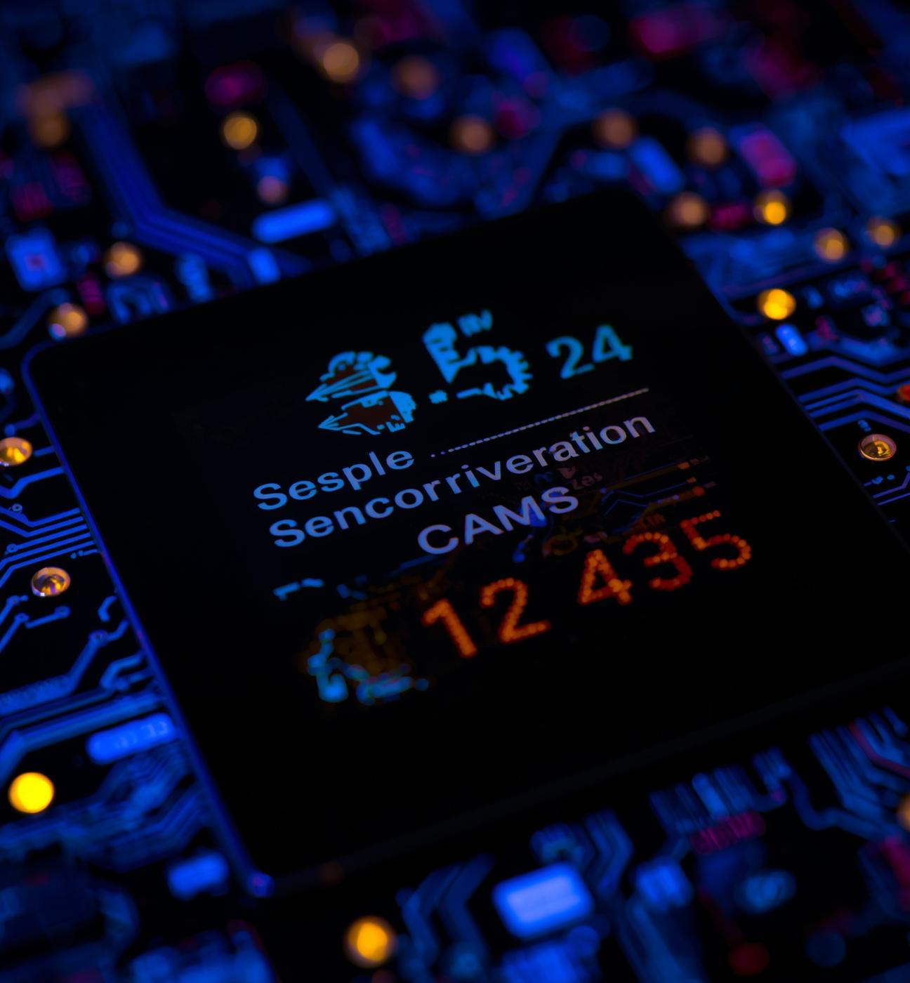
Results
The live OLED data display provides immediate feedback on gas levels and environmental conditions. Sensor data is continuously monitored, ensuring prompt alerts for any hazardous situations. This real-time visibility enhances safety measures, allowing users to respond swiftly to potential threats.

Slide 12
Thank You

